Slide 1
Paralympics and Sport rehabilitation
Academic Year 2024-2025
26.06.2025

Slide 2
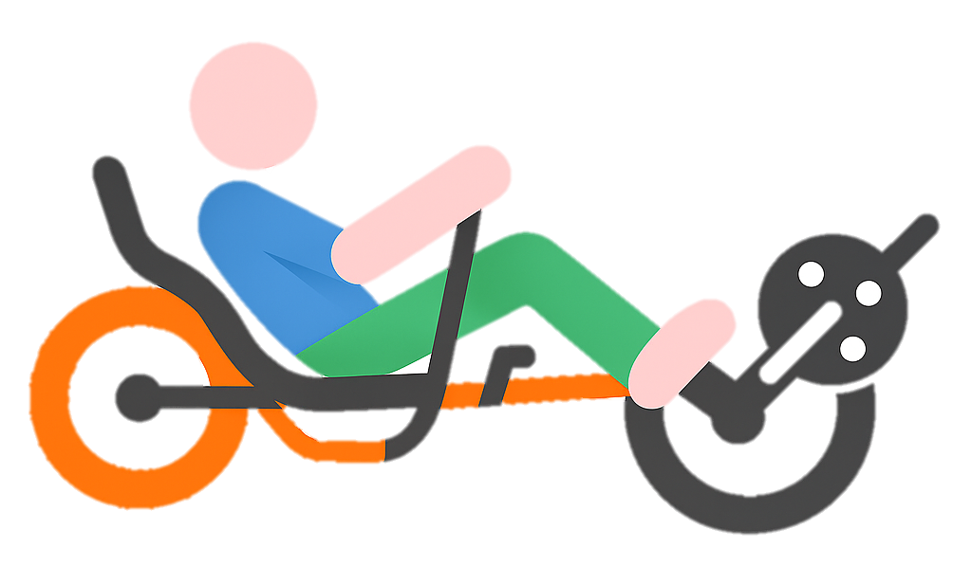
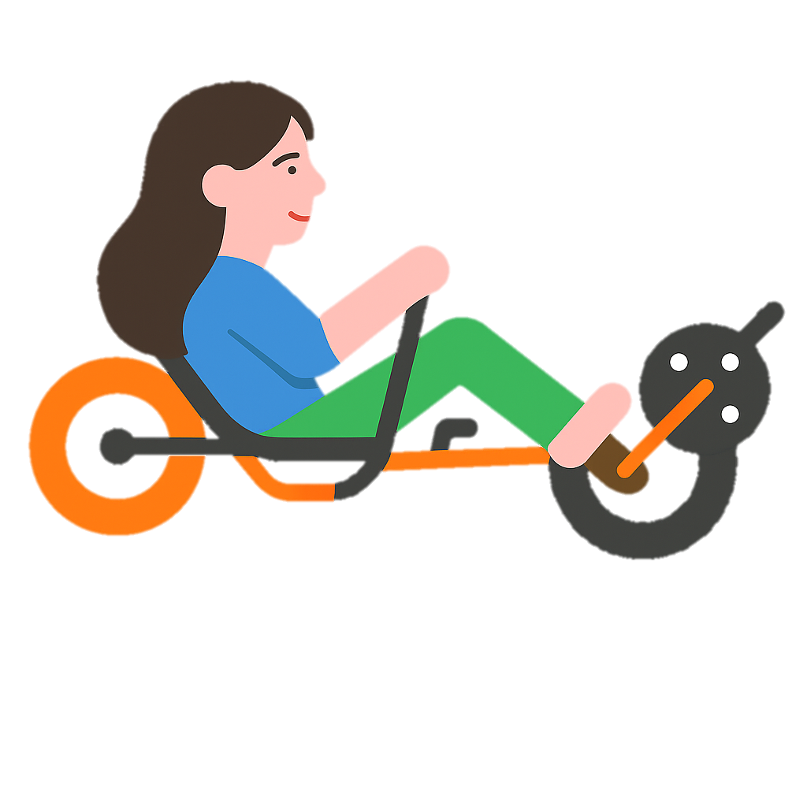

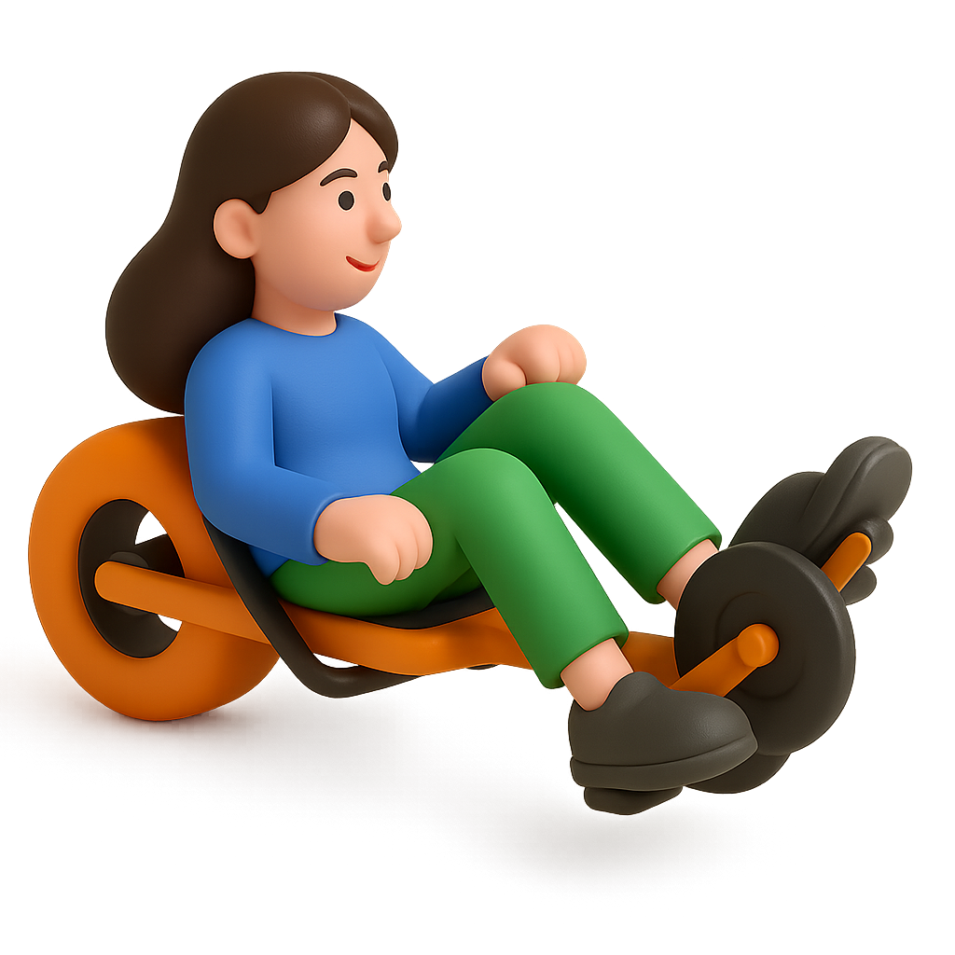
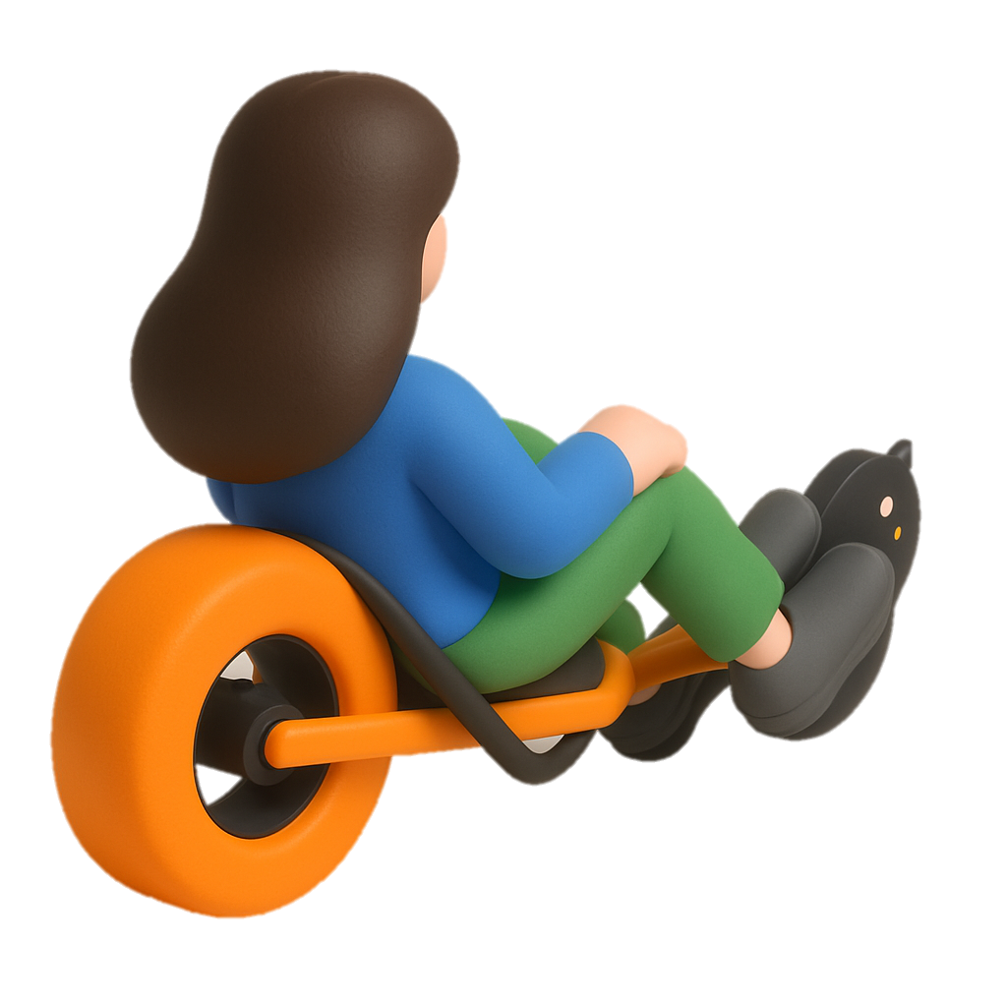
Cushion with Independent Air Chambers + Pressure-Sensitive Mat
Amari Giacomo | 10698309
Milazzo Alessandro Giuseppe | 10766415
Traversi Gloria | 10816956
Usai Chiara | 11005835
Zanoni Chiara | 10784594
26.06.2025
08.04.2025
25.03.2025
Focus group
Proposal
Final work
Introduction
Project proposal
Project design
Challenges
Conclusion

Slide 3


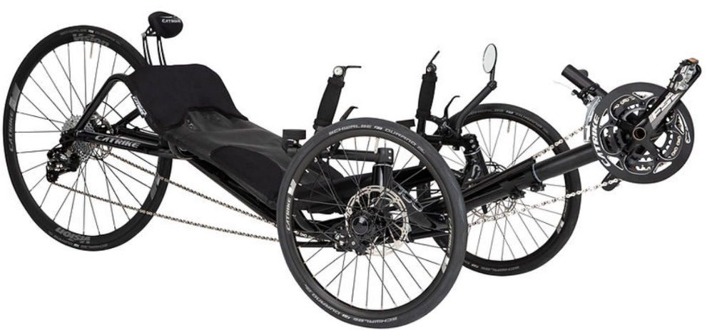
Spinal Cord Injuries and FES
Over 15 million people worldwide live with spinal cord injuries (SCI).
Functional electrical stimulation (FES) during pedaling exercises help improve an SCI person’s physical and psychological well-being → FES-cycling.
The trike we use is a modified commercial recumbent tricycle (CATRIKE 700).
Sanna, N., Nossa, R., Biffi, E., Guanziroli, E., Diella, E., Ferrante, S., Molteni, F., Peruzzo, D., Nicola, C., Alfonso, M., Rizzo, G., Tarabini, M., Pedrocchi, A., & Ambrosini, E. (2025). Evaluating the Health and Fitness Benefits of a 6-Month FES-Cycling. Program on a Recumbent Trike for Individuals with Motor Complete SCI: A Pilot Study.
Everaert, D. G., Okuma, Y., Abdollah, V., & Ho, C. (2021). Timing and dosage of FES cycling early after acute spinal cord injury: A case series report.
Savona, D., Zanco, C., Sanna, N., Pedrocchi, A., & Ambrosini, E. (2024). A functional Electrical Stimulation and Motor-Assisted trike for sport rehabilitation therapy. 2022 9th IEEE RAS/EMBS International Conference for Biomedical Robotics and Biomechatronics
Introduction
Project proposal
Project design
Challenges
Conclusion

Slide 4


User-center need
MITIGATE DISCOMFORT
Healthy individual: In-Chair Movements (ICM)
Individual with SCI: lifting themselves from the chair using their arms → not possible during training or competition
Risk of PRESSURE ULCERS: prolonged compression that damages the skin and underlying tissues.
The project aims to address this issue by improving safety and comfort of athletes on the trike.
Fenety, A., & Walker, J. M. (2002). Short-Term effects of workstation exercises on musculoskeletal discomfort and postural changes in seated video display unit workers.
Vergara, M., & Page, Á. (2002). Relationship between comfort and back posture and mobility in sitting-posture.
Project proposal
Introduction
Project design
Challenges
Conclusion

Slide 5
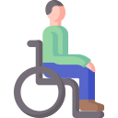




Requirements
prevent pressure sores
The FUNCTIONAL requirements are related to the behaviour and performance of the system and are essential for the correct use of the device.
ensure user comfort
maintain postural stability
be adaptable to the trike
be waterproof and resistant
Project proposal
Introduction
Project design
Challenges
Conclusion

Slide 6
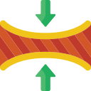




Requirements
not bulky and lightweight
The NON - FUNCTIONAL requirements refer to aspects that do not directly affect how the system works. They are important to ensure a good user experience.
easy to carry
easy to use
simple to maintain
Project proposal
Introduction
Project design
Challenges
Conclusion

Slide 7
Cushion with Independent Air Chambers + Pressure-Sensitive Mat
26.06.2025
08.04.2025
25.03.2025
Focus group
Proposal
Project design
Introduction
Project proposal
Challenges
Conclusion

Slide 8
Cushion with Independent Air Chambers + Pressure-Sensitive Mat
The independent cell cushion is designed to adjust the air within the chambers in response to pressure changes detected by the MAT, thereby reducing pressure overload and improving load distribution.
26.06.2025
08.04.2025
25.03.2025
Focus group
Proposal
Project design
Introduction
Project proposal
Challenges
Conclusion

Slide 9
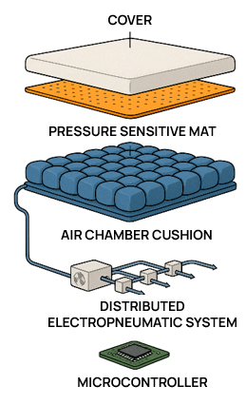
Cushion with Independent Air Chambers + Pressure-Sensitive Mat
1
Material
Sensors
Embedded Systems
3
2
Cells
Material
Compressor
ON/OFF Solenoid Valve
Check Valve
Electropneumatic Valve
Mechanical Release Valve
4
Arduino
Software
5
Project design
Introduction
Project proposal
Challenges
Conclusion

Slide 10
Cover
The cover is the direct interface with the user.
MICROPOROUS POLYURETHANE (PU) (150–250 µm thickness)
comfort
hygiene
breathability
waterproofness
mechanical resistance
10% binder (Tubicoat PUT), 2% thickener (Tubicoat ASD 60), 2% crosslinker (Fixerer MF 200), 3% softener (Microsil 500), and 4% water repellent (Tubicoat A711).
Vergara, M., & Page, Á. (2002). Relationship between comfort and back posture and mobility in sitting-posture.
ITTTAI Technologies - ITTTAI. Available at: https://itttai.com/en/technologies/itttai-technologies
Project design
Introduction
Project proposal
Challenges
Conclusion

Slide 11
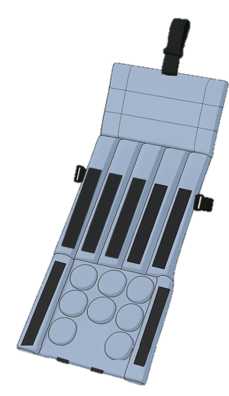
Cushion
Ensuring the stability of the cushion
fastening system,
velcro strips.
Cushion on the shoulder area
1
Cells on the backrest
6
Cells on the seat
11
Project design
Introduction
Project proposal
Challenges
Conclusion

Slide 12
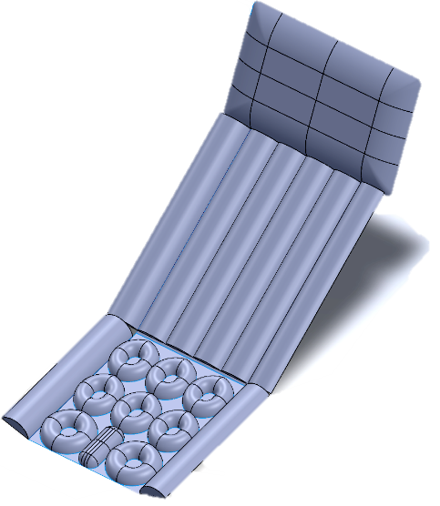
Cushion : cells
Flow Advance mattress → SolidWorks → 17 air cells in total, 12 of which are dynamically controlled.
Cells on the seat:
two lateral semicylindrical not dynamically controlled;
one rectangular static;
six rear elliptical dynamically controlled;
two anterior circular dynamically controlled.
Cushion on the shoulder area:
one without air cells.
1
11
Cells on the backrest:
two lateral semicylindrical, not dynamically controlled;
four central semicylindrical, dynamically controlled.
6
Robinson, J., Shewalkar, V., Rigo, I., Rock, A., Cinnamon, L., Chapman-Rienstra, D., Hong, J., Kim, J., & Golecki, H. (2023). DESIGN OF a CUSTOM SENSING AND ACTUATING CUSHION FOR USE IN PRESSURE RELIEF IN WHEELCHAIR USERS. 2017
Project design
Introduction
Project proposal
Challenges
Conclusion

Slide 13
Cushion: material
Based on the description of the Flow Advance system.
POLYURETHANE FIBER (PU) (0.2 mm and 0.5 mm thickness)
elastic
biocompatible
resistant
welding techniques
Each cell has an integrated fitting that connects the chamber to the pneumatic tubing.
Flow advance : Sistema Antidecubito dinamico (2023) Service Med. Available at: https://www.servicemed.it/prodotti/sistemi-antidecubito-attivi-ad-aria/flow-advance
Sartorato, G. (2022) Sistema antidecubito AD Altissimo Rischio flow advance, Nurse24.it. Available at: https://www.nurse24.it/dossier/wound-care/sistema-antidecubito-flow-advance-ad-altissim
Euro Ausili S.r.l. (n.d.). Genius: Low continuous pressure antidecubitus system with 3 differentiated zones [Brochure]. Available at https://www.euroausili.it/
Project design
Introduction
Project proposal
Challenges
Conclusion

Slide 14
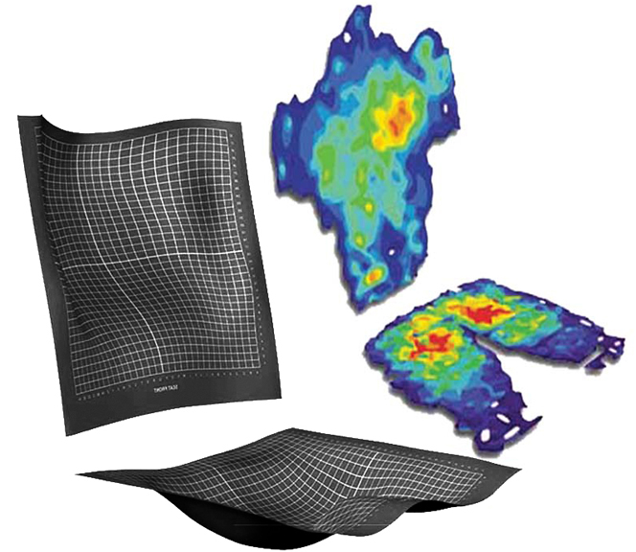
Pressure sensitive MAT: sensors
Two sensor mats: Tekscan CONFORMat™ system in the Research configuration. NOT use all 2000 sensors → actively select only 672 SENSORS grouped into 12 logical areas.
On the seat:
the 6 rear cells are monitored by 32 sensors each;
the 2 larger front cells are monitored by 40 sensors each.
In total, the seat uses 272 sensors.
On the backrest: each cell was associated with 100 sensors.
A total of 400 sensors distributed across 4 cells.
https://www.tekscan.com/products-solutions/systems/body-pressure-measurement-system-bpms-research
Project design
Introduction
Project proposal
Challenges
Conclusion

Slide 15


Pressure sensitive MAT: embedded systems
Data exported in real-time in ASCII format using a proprietary format (FSX) not compatible with embedded systems like Arduino.
Software bridge that converts the data into a format readable by Arduino.
Software Development Kit (SDK) provided by Tekscan and its related Application Programming Interfaces (APIs): enables the development of custom applications in a Windows environment.
Project design
Introduction
Project proposal
Challenges
Conclusion

Slide 16
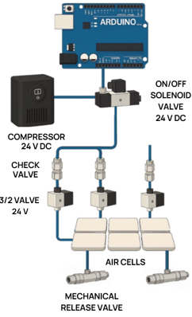
Distributed electropneumatic system
COMPRESSOR, the main source of compressed air.
24 V
Project design
Introduction
Project proposal
Challenges
Conclusion

Slide 17
Distributed electropneumatic system
ON/OFF SOLENOID VALVE, normally closed, which acts as the main pneumatic switch for the entire system.
COMPRESSOR, the main source of compressed air.
Project design
Introduction
Project proposal
Challenges
Conclusion

Slide 18
Distributed electropneumatic system
ON/OFF SOLENOID VALVE, normally closed, which acts as the main pneumatic switch for the entire system.
COMPRESSOR, the main source of compressed air.
CHECK VALVE, allows air to flow only toward the cell.
3/2 ELECTRO PNEUMATIC VALVE, normally closed, ensures air direction.
Project design
Introduction
Project proposal
Challenges
Conclusion

Slide 19
Distributed electropneumatic system
ON/OFF SOLENOID VALVE, normally closed, which acts as the main pneumatic switch for the entire system.
COMPRESSOR, the main source of compressed air.
CHECK VALVE, allows air to flow only toward the cell.
3/2 ELECTRO PNEUMATIC VALVE, normally closed, ensures air direction.
MECHANICAL RELEASE VALVE keeps the internal pressure within safe limits.
Project design
Introduction
Project proposal
Challenges
Conclusion

Slide 20
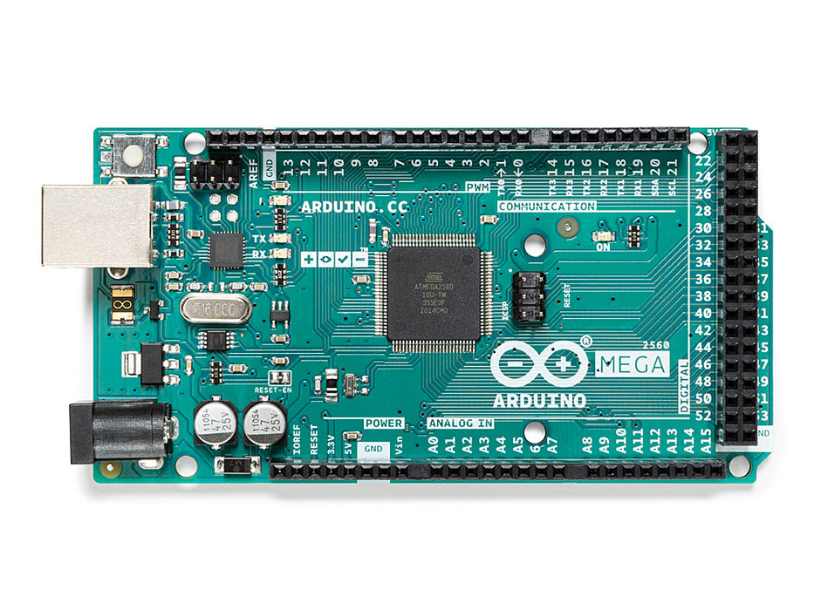
Microcontroller: Arduino
Arduino Mega 2560: the central control unit of the entire system.
Acquisition of pressure data from the MAT via a USB connection. Processing frequency: 10 Hz.
https://store.arduino.cc/products/arduino-mega-2560-rev3?srsltid=AfmBOoriXWEOzhxUq7rx2pqrkn9Ff-agWQZqJYAiDKFTW4Y360G7kTXg
The microcontroller manages the control of the electro-pneumatic system, using digital output pins :
twelve for the individual control of 3/2 electro-pneumatic valves,
one dedicated pin for the main ON/OFF valve,
one additional pin for the compressor.
Valves and compressor require higher currents than those the microcontroller can supply directly → RELAY CIRCUITS.
Project design
Introduction
Project proposal
Challenges
Conclusion

Slide 21


Microcontroller: software
THE SYSTEM
Developed in C++ using the Arduino IDE
The real-time control of the 12 pneumatic cells by processing pressure data at 10 Hz
During the setup phase, it was ESTIMATED that the cell volume was 5 L at ambient pressure. To reach 0.2 MPa (~10 L at pressure), 17.14 s of inflation are needed using a 35 L/min compressor.
Project design
Introduction
Project proposal
Challenges
Conclusion

Slide 22


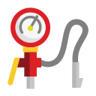
Microcontroller: software
AT SYSTEM STARTUP
all cells are inflated for 20 s to ensure operational pressure
DURING NORMAL USE
the system performs a brief general inflation every 3 min
Pressure control on each individual sensor:
calculation and monitoring of average pressures based on the Reswick and Rogers curve,
triggering automatic interventions if the 300 mmHg hour threshold is exceeded.
Gefen, A. (2009). Reswick and Rogers pressure-time curve for pressure ulcer risk.
Project design
Introduction
Project proposal
Challenges
Conclusion

Slide 23

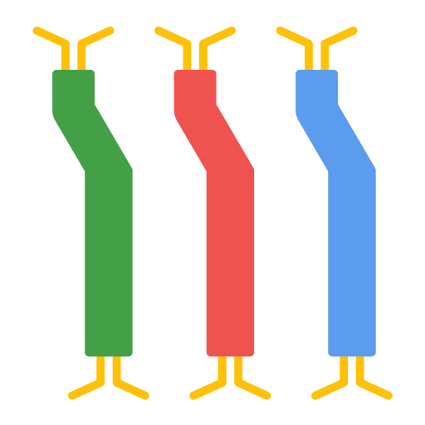

Steps for future improvements
Shape and number of air chambers: balance ergonomics and technical simplicity.
Wiring: holes in the trike frame to pass the air tubes under the frame. A net under the frame could hold the tubes and valves neatly, making the system lighter, safer, and better organized.
Software interface: to make software bridge usingTekscan SDK.
Outdoor use and total weight: we need to make lighter versions.
Challenges
Introduction
Project proposal
Project design
Conclusion

Slide 24
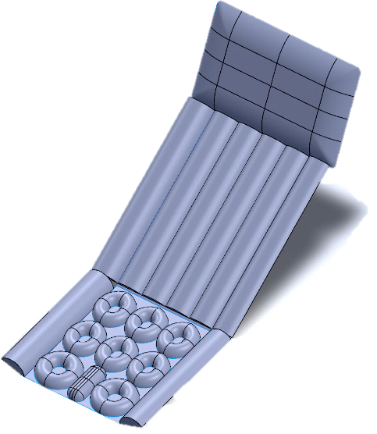
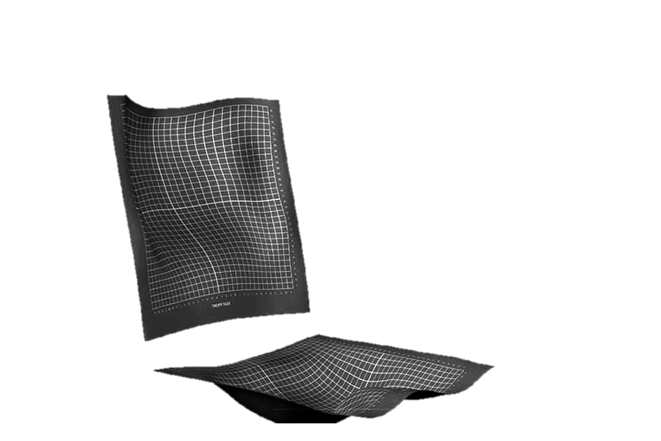
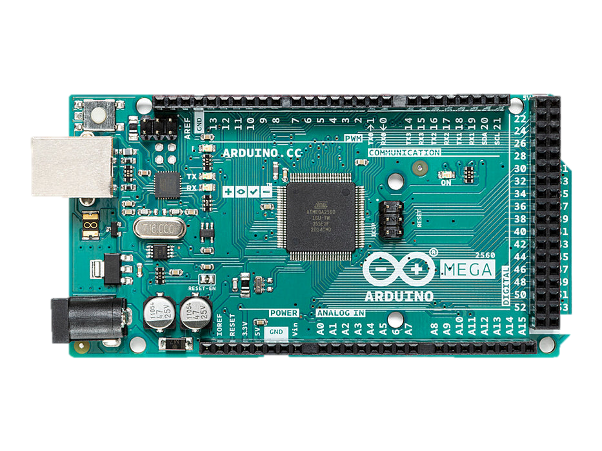
26.06.2025
08.04.2025
25.03.2025
Focus group
Proposal
Conclusion
Introduction
Project proposal
Project design
Challenges

Slide 25
CUSHION
Cells, Material
PRESSURE SENSITIVE MAT
Sensors, Embedded Systems
MICROCONTROLLER
Arduino, Software
08.04.2025
25.03.2025
Focus group
Proposal
26.06.2025
Conclusion
Introduction
Project proposal
Project design
Challenges

Slide 26
Paralympics and Sport rehabilitation
Academic Year 2024-2025
26.06.2025

Slide 27
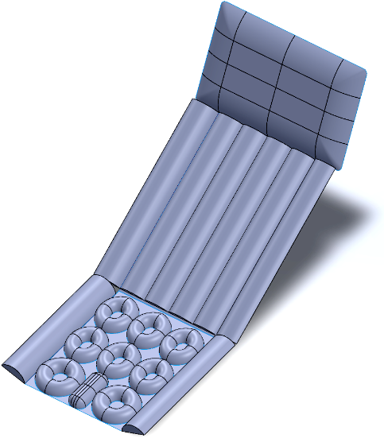
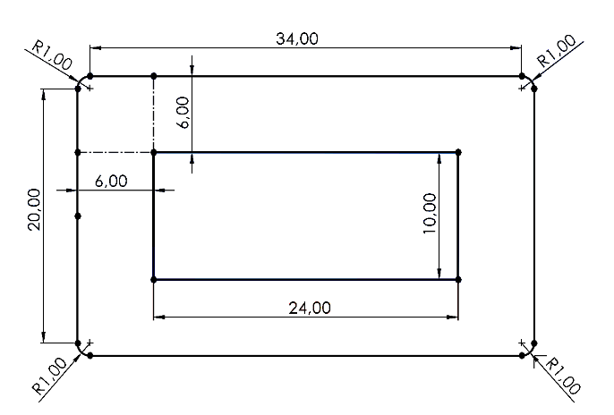
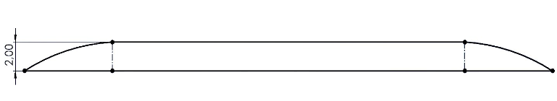
Final CAD dimensions
Project design
Introduction
Project proposal
Challenges
Conclusion

Slide 28
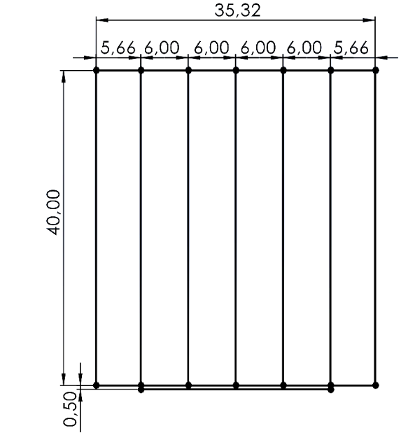
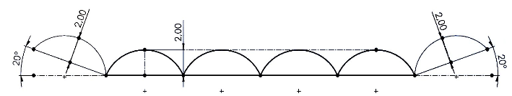
Final CAD dimensions
Project design
Introduction
Project proposal
Challenges
Conclusion

Slide 29
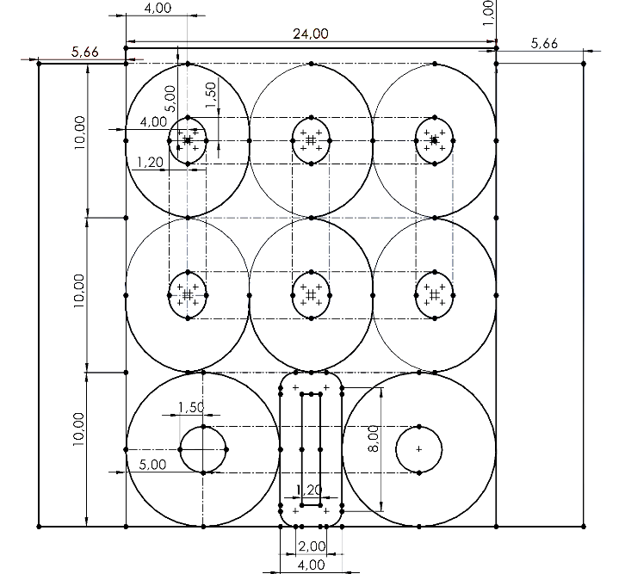
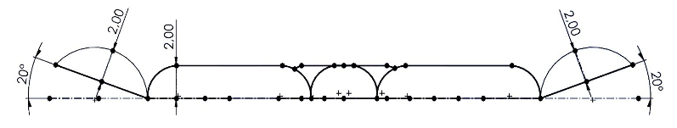
Final CAD dimensions
Project design
Introduction
Project proposal
Challenges
Conclusion

Slide 30
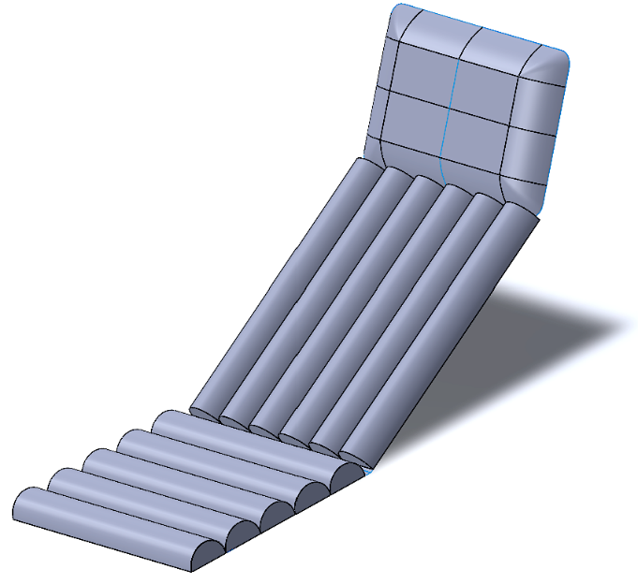
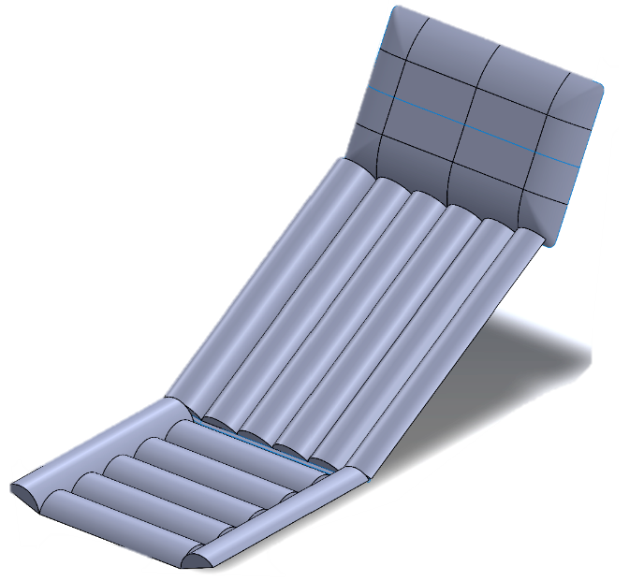
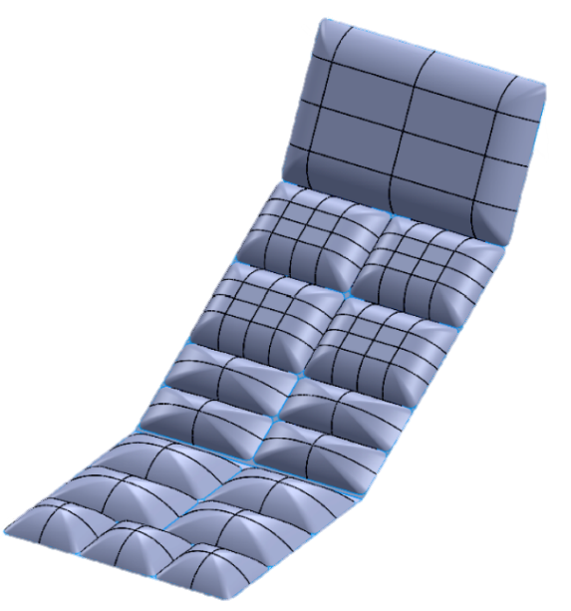
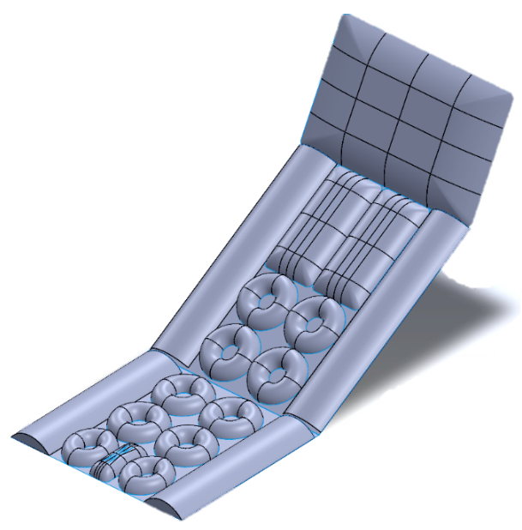
Alternative CAD designs
Project design
Introduction
Project proposal
Challenges
Conclusion

Slide 31
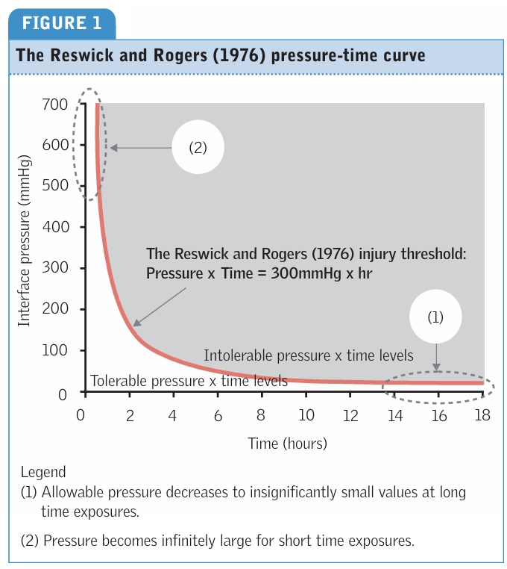
Reswick and Rogers curve
Project design
Introduction
Project proposal
Challenges
Conclusion

Slide 32
Overall cost estimate
COMPONENT | COMMERCIAL EXAMPLE | APPROXIMATE PRICE (EUR)
AIR CELL CUSHION | Custom or OEM (e.g., Roho, Vicair) | ~3,000–5,000 €
BREATHABLE COVER | Micro-perforated PU cover | ~200–300 €
MATS | Tekscan CONFORMat system | ~13,000 €
COMPRESSOR (24 V DC) | CAFELE 24 V air compressor | ~38 €
ON/OFF VALVE (2/2) | Heschen 2V025-08 24 V DC | ~12 €
3/2 VALVES (12 UNITS) | Heschen 3V210-08 24 V DC | ~12 € each
CHECK VALVES (12 UNITS) | EFUTURETIME 10 mm quick-connect | ~5 € each
SAFETY VALVES (12 UNITS) | Aurorad 2 bar ½″ | ~6 € each
RELAY BOARDS (2 UNITS) | ARCELI 8-channel 5 V | ~5 €
COMPRESSOR RELAY | CGEAMDY 24 V 30 A automotive relay | ~12 €
WIRING AND PROTECTION | 16 AWG cables, fuses, 1N4007 diodes | ~10–15 € total
Project design
Introduction
Project proposal
Challenges
Conclusion

Slide 33



Focus group
ANDREA
Experience: various races
Issues: safety, comfort, upper limbs, outdoor
Purpose: use with families and friends
DAVIDE
Experience: various races
Issues: transporting the trike, customization, comfort, safety, outdoor
Purpose: autonomous training
ALESSANDRO
Experience: training
Issues: safety, comfort, upper limbs, outdoor
Purpose: total body training
Project proposal
Introduction
Project design
Challenges
Conclusion

